Slide 1
Do Now
Two students were interested in learning if coffee stays hotter for longer if you use a plastic cup or paper cup. For this experiment:
1. Identify the independent variable
2. Identify the dependent variable
3. Identify two controlled variables
4. Write a hypothesis

Slide 2
Do Now
Two students were interested in learning if coffee stays hotter for longer if you use a plastic cup or paper cup. For this experiment:
1. Independent variable: The cup’s material
2. Dependent variable: The coffee temperature
3. Controlled variables: The coffee itself, the coffee’s environment, whether milk was added
4. Write a hypothesis: The coffee in the plastic cup will stay hotter for longer

Slide 3
Tips to writing a good method:
Keep it clear and concise
Everything should be written in past tense
Make it step-by-step, in order of how you did it!
A method is a set of instructions that someone has followed, which is why it needs to be in the past tense.

Slide 4
Tips to writing a good method:
Keep it clear and concise
Everything should be written in past tense
Make it step-by-step, in order of how you did it!
A method is a set of instructions that someone has followed, which is why it needs to be in the past tense.

Slide 5
Observation
Using our senses
Inference
What we think is happening
Data
Information from the experiment
Aim
Why we’re doing an experiment
Method
What somebody did in an experiment

Slide 6
Variable
Any thing that can affect the experiment
Independent Variable
What we purposefully change
Dependent Variable
What is measured
Controlled Variable
What is kept the same
Hypothesis
What we expect to happen

Slide 7
Graphing
Success Criteria
I can interpret a graph
I can identify what graph type is needed for qualitative or quantitative data
I can label and title graphs appropriately

Slide 8
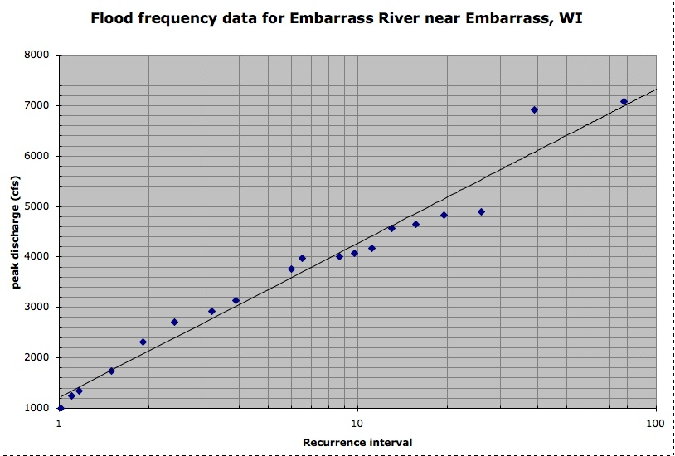
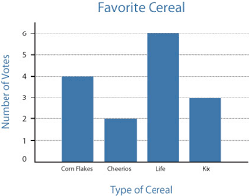
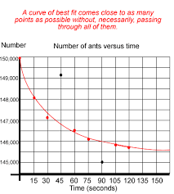
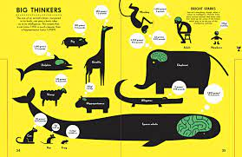
I can interpret a graph
Think – Pair – Share
Are there any times that you have used, or seen someone use, pictures to describe something when words weren’t going to help?
Think about your answer quietly
When instructed, share with a partner
When asked, share with the class.

Slide 9
I can interpret a graph
Time in Air (s) | Height (cm)
1 | 95
2 | 180
3 | 256
4 | 322
5 | 377
6 | 423
7 | 460
8 | 486
9 | 503
10 | 510
11 | 506
12 | 494
13 | 471
14 | 439
15 | 396
16 | 344
17 | 282
18 | 211
19 | 129
20 | 38
Often, it makes sense to interpret data from a graph. We do this because it is easier to look for trends and summarise results with a graph than a table of numbers!
Consider which is easier to read – this table of results, or this graph:

Slide 10
I can interpret a graph
Time in Air (s) | Height (cm)
1 | 95
2 | 180
3 | 256
4 | 322
5 | 377
6 | 423
7 | 460
8 | 486
9 | 503
10 | 510
11 | 506
12 | 494
13 | 471
14 | 439
15 | 396
16 | 344
17 | 282
18 | 211
19 | 129
20 | 38
Looking at the graph, we can interpret two things:
The ball is rising in the air up until 10 seconds
After 10 seconds, the ball falls down again
Much easier to tell from the graph than the table!

Slide 11
I can interpret a graph
We can use graphs to determine if our hypothesis was correct. The graph below shows the effect of water on plant height.
If the hypothesis was: As amount of water increases, the plant height increases.
Then, our hypothesis would’ve been correct!

Slide 12
I can interpret a graph
Using the graph on the right, what is true for concentration of acid and the weight of paper it destroyed?
As acid concentration increases, the weight difference decreases.
As acid concentration decreases, the weight difference decreases.
As acid concentration increases, the weight difference increases.
As acid concentration decreases, the weight difference increases.

Slide 13
I can interpret a graph
Using the graph on the right, what is true for concentration of acid and the weight of paper it destroyed?
As acid concentration increases, the weight difference decreases.
As acid concentration decreases, the weight difference decreases.
As acid concentration increases, the weight difference increases.
As acid concentration decreases, the weight difference increases.

Slide 14
I can interpret a graph
Using the graph on the right, what is true for the amount of electricity a solar panel made based on the distance from the light?
As distance increases, the electricity generated decreases.
As distance decreases, the electricity generated decreases.
As distance increases, the electricity generated increases.
As distance decreases, the electricity generated increases.

Slide 15
I can interpret a graph
Using the graph on the right, what is true for the amount of electricity a solar panel made based on the distance from the light?
As distance increases, the electricity generated decreases.
As distance decreases, the electricity generated decreases.
As distance increases, the electricity generated increases.
As distance decreases, the electricity generated increases.

Slide 16
I can interpret a graph
Using the graph on the right, what is the favourite fruit for this particular class?
Oranges
Apples
Mangoes
Bananas

Slide 17
I can interpret a graph
Using the graph on the right, what is the favourite fruit for this particular class?
Oranges
Apples
Mangoes
Bananas

Slide 18

Brain Break
In this video, two of the facts shown are true, and the other is false. See if you can identify which is which before the end!
Notes:
https://www.youtube.com/shorts/kHQVPt4Oehg if video doesn’t work

Slide 19
I can identify what graph type is needed for qualitative or quantitative data
There are two types of data you’ll ever use:
Numerical data, where the data is based on numbers and measurements (like height and age)
Categorical data, where the data is based on categories or qualities (like colour and shape)
For numerical data, we tend to use scatter-plots.
For categorical data, we instead use bar graphs.
Numerical data is sometimes called quantitative data, and categorical is called qualitative.

Slide 20
I can identify what graph type is needed for qualitative or quantitative data
Let’s say we were interested in the favourite fruit of different students. Since this is categorical data, we make a bar graph:
If instead we were interested in the amount of energy made by a solar panel, we would instead use a scatter-plot:

Slide 21
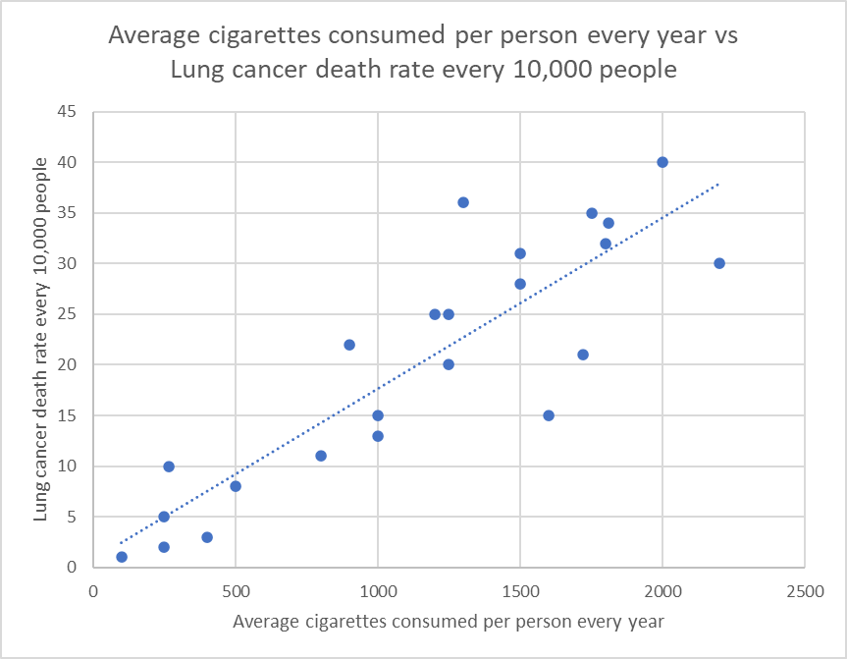
I can identify what graph type is needed for qualitative or quantitative data
Sometimes, to make scatter-plots easier to read, we will draw a line of best-fit. This is when we draw a shape that is smooth and goes through or near as many of the dots as possible.

Slide 22
I can label and title graphs appropriately
All graphs must have the following 3 things to be considered correct:
A title. The easiest way to write a title is to simply state the independent and dependent variables.
A consistent scale. That means the numbers go up the same amount each time!
Axis labels, including the units for what you are measuring. The independent variable goes on the x-axis, and the dependent variable goes on the y-axis.

Slide 23
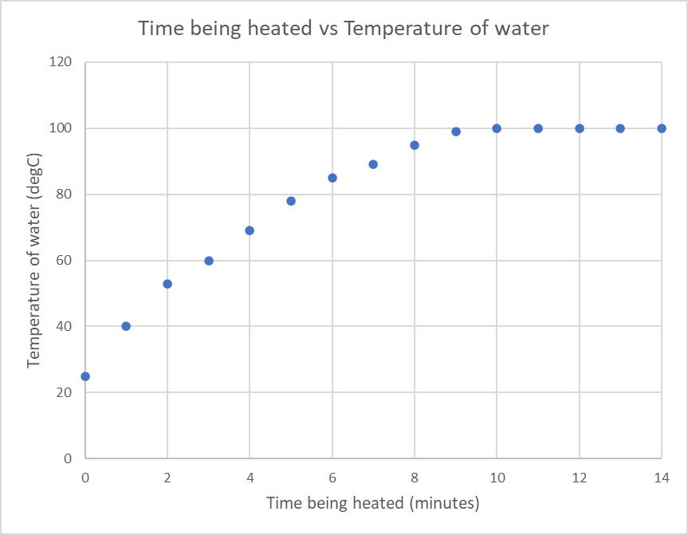
I can label and title graphs appropriately
Title
Includes the independent and dependent variable
y-axis
The dependent variable
Include a title and units
Data points
Clearly shown
Scales
Evenly spaced
x-axis
The independent variable
Include a title and units

Slide 24

Brain Break
In this video, two of the facts shown are true, and the other is false. See if you can identify which is which before the end!
Notes:
https://www.youtube.com/shorts/NmLnNVTNNqc if video doesn’t work

Slide 25
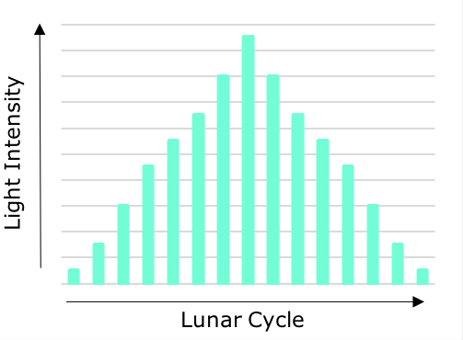
I can label and title graphs appropriately
What is a title you would use for this graph?

Slide 26
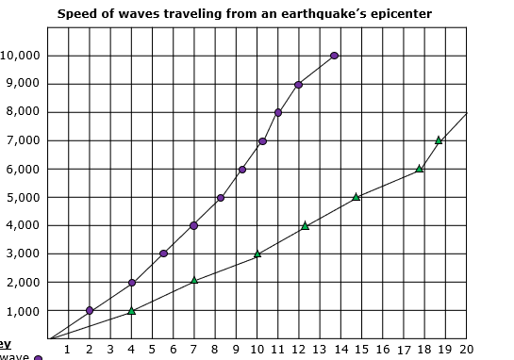
I can label and title graphs appropriately
What is this graph missing?

Slide 27

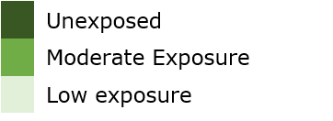
I can label and title graphs appropriately
This graph has been drawn incorrectly.
What is missing from this graph?
Salmon Swimming Speed with Exposure to Oil
Swimming Speed

Slide 28
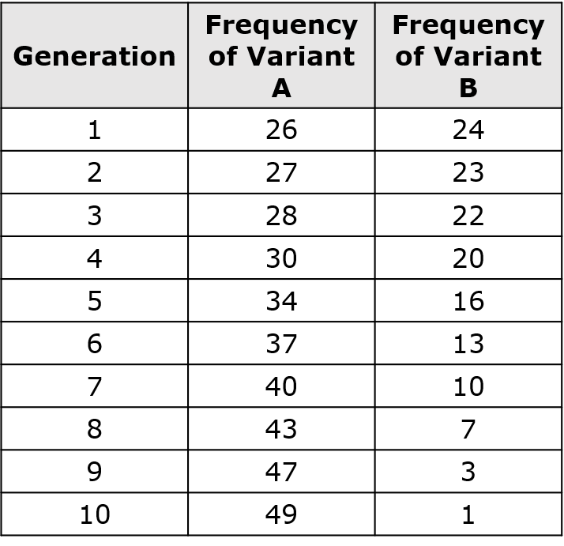
I can label and title graphs appropriately
What kind of a graph would you use for this table of data?
Frequency of Genetic Traits
in Bacteria Over Time

Slide 29
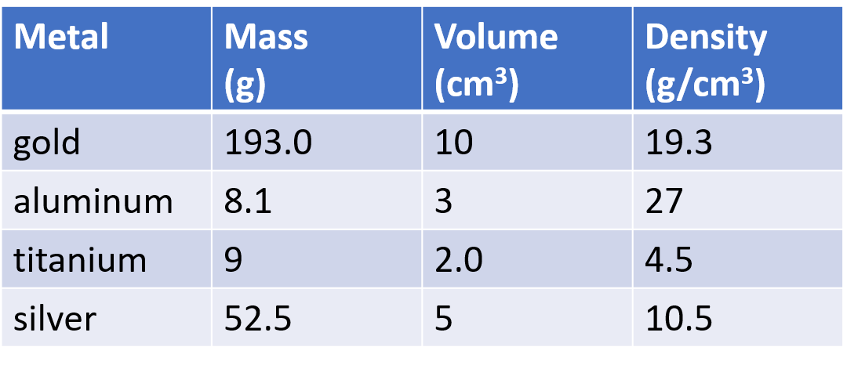
I can label and title graphs appropriately
What kind of a graph would you use for this table of data if you were only interested in the density of each metal?

Slide 30
Graphing
Graphs are very useful ways of displaying data.
All graphs must have the following three things:
A title.
A consistent scale.
Axis labels, including the units for what you are measuring.
Writing these are much easier with practice and by using your independent and dependent variables.

Slide 31
Variables and hypothesis
Time in Air (s) | Height (cm)
1 | 95
2 | 180
3 | 256
4 | 322
5 | 377
6 | 423
7 | 460
8 | 486
9 | 503
10 | 510
11 | 506
12 | 494
13 | 471
14 | 439
15 | 396
16 | 344
17 | 282
18 | 211
19 | 129
20 | 38
It is often easier to visualise data in picture form than by using tables of numbers.
Using the ball throwing example from earlier in the lesson, it is much easier to see what’s going on when you graph the data and add a curve of best-fit

Slide 32
Graphing
Success Criteria
I can interpret a graph
I can identify what graph type is needed for qualitative or quantitative data
I can label and title graphs appropriately

